Slide 1

WEBSITE SELLING TECHNOLOGY STUFF
GB
GROUP B

Slide 2

Team Members
Le Nguyen Duc Manh (Leader)
Nguyen Le Bao Thanh
Nguyen Dang Khanh Van
Ly Truong Son
Ngo Minh Hoang

Slide 3

Introduction
Website selling technology stuff (WSTS) is a solution tool that is designed to track and maintain the details of products.
It manages all the data generated by a system, including the type of product, product information, etc.

Slide 4

Objective
The main of a website selling technology stuff is to manage the details of Profiles, Products, Orders, …
It manages all the information about Profiles, Products and Orders.
The project is built for customer purchase and administrator access to product management.

Slide 5

Purpose
To develop an online system to help admin.
To manage the details of products.
To bring the website to customers can use and buy products.

Slide 6
Project Scope
Our project aims for the safe and easy handling of product data, we have made a process to store data and distribution.
It is easy and safe to store data.
It is easy to operate.
Have a good user interface.
It helps the admin handle the products data.
We have tried to develop safe and secure software with the above-mentioned specifications.
Scope of change: comment products.

Slide 7


Used Tools and Technology
Frontend: Angular
Back end: Spring Tool Suite
Oracle Database
Online tools:
Word pad
Notepad

Slide 8
Module
We have an admin module along with that we have some other modules:
Cart
Dashboard
Order Details
Order
Product
Product Single
Profile Details
Login
Sign Up

Slide 9


Frontend Tool
We used:
Angular
CSS
HTML
Java Script
Typescript

Slide 10


Backend [language used]
JAVA
SPRING BOOT
SPRING DATA JPA

Slide 11

DATABSE
Oracle SQL

Slide 12
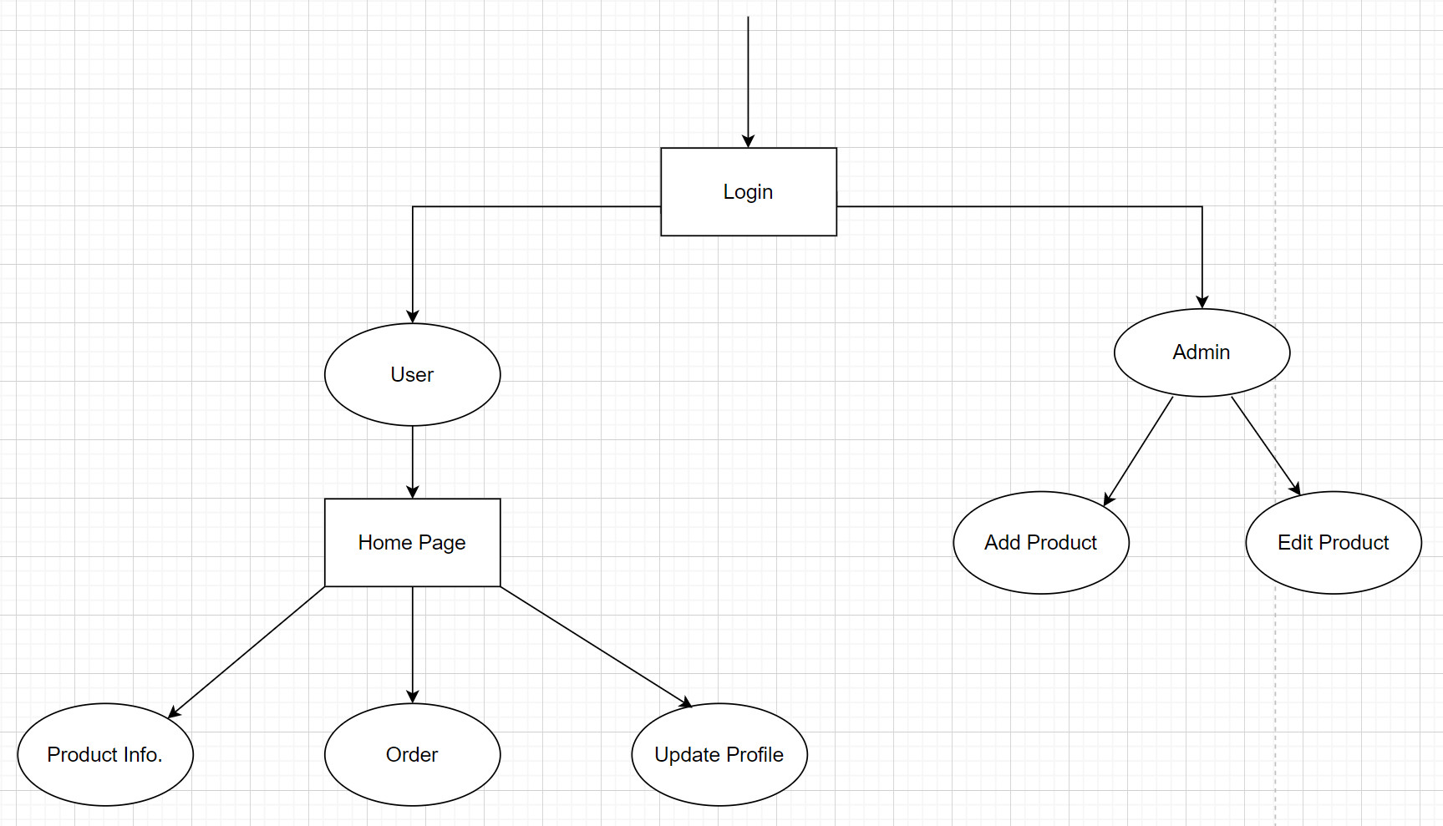
DATA FLOW DIAGRAM

Slide 13
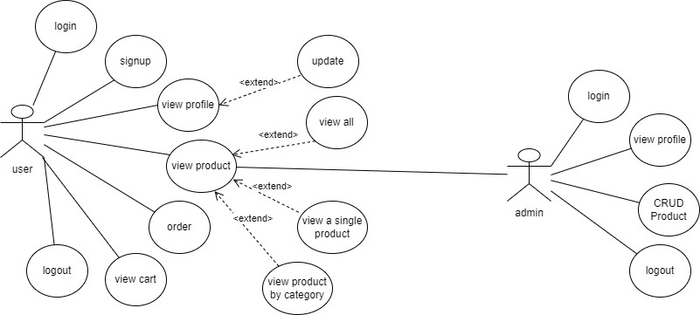
USE CASE DIAGRAM

Slide 14
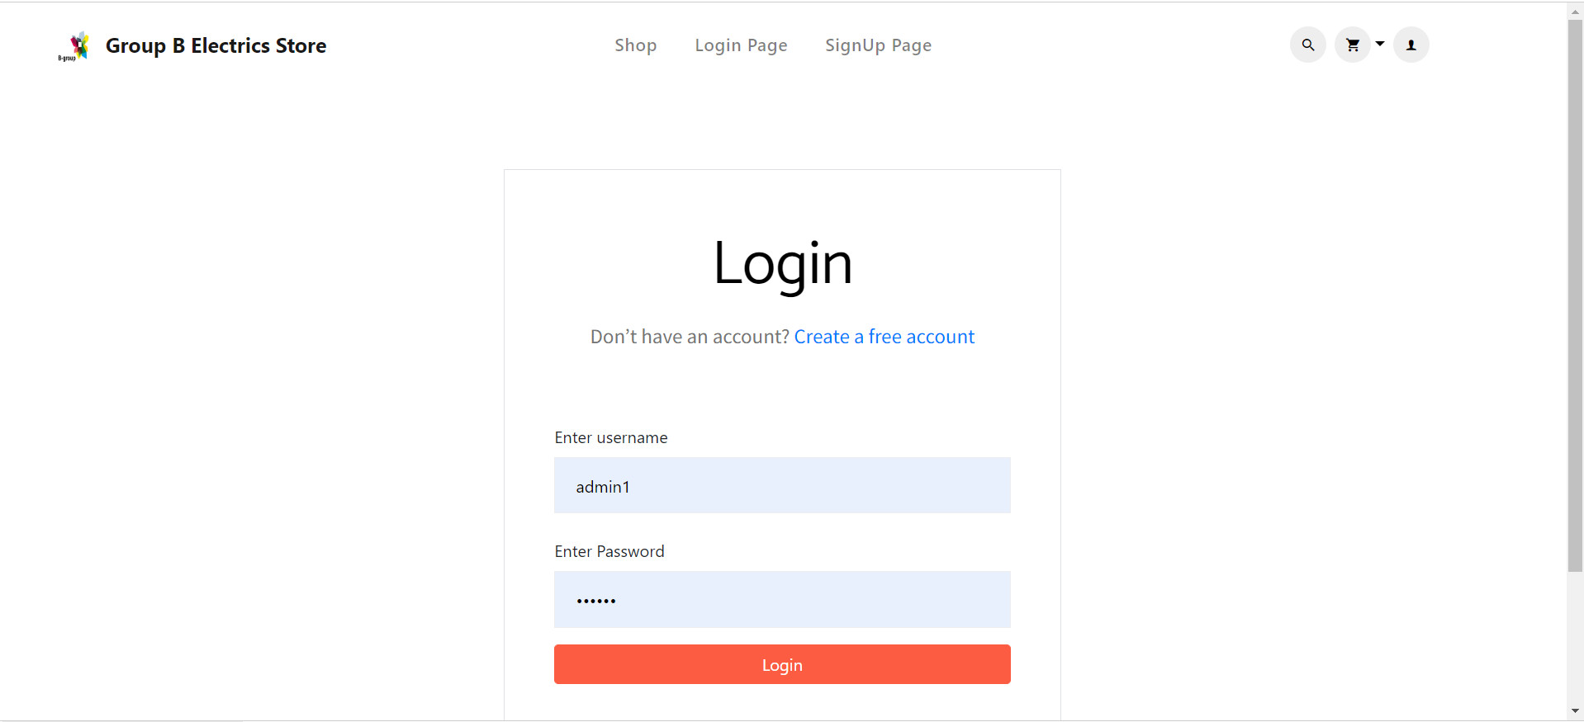
LOGIN PAGE

Slide 15
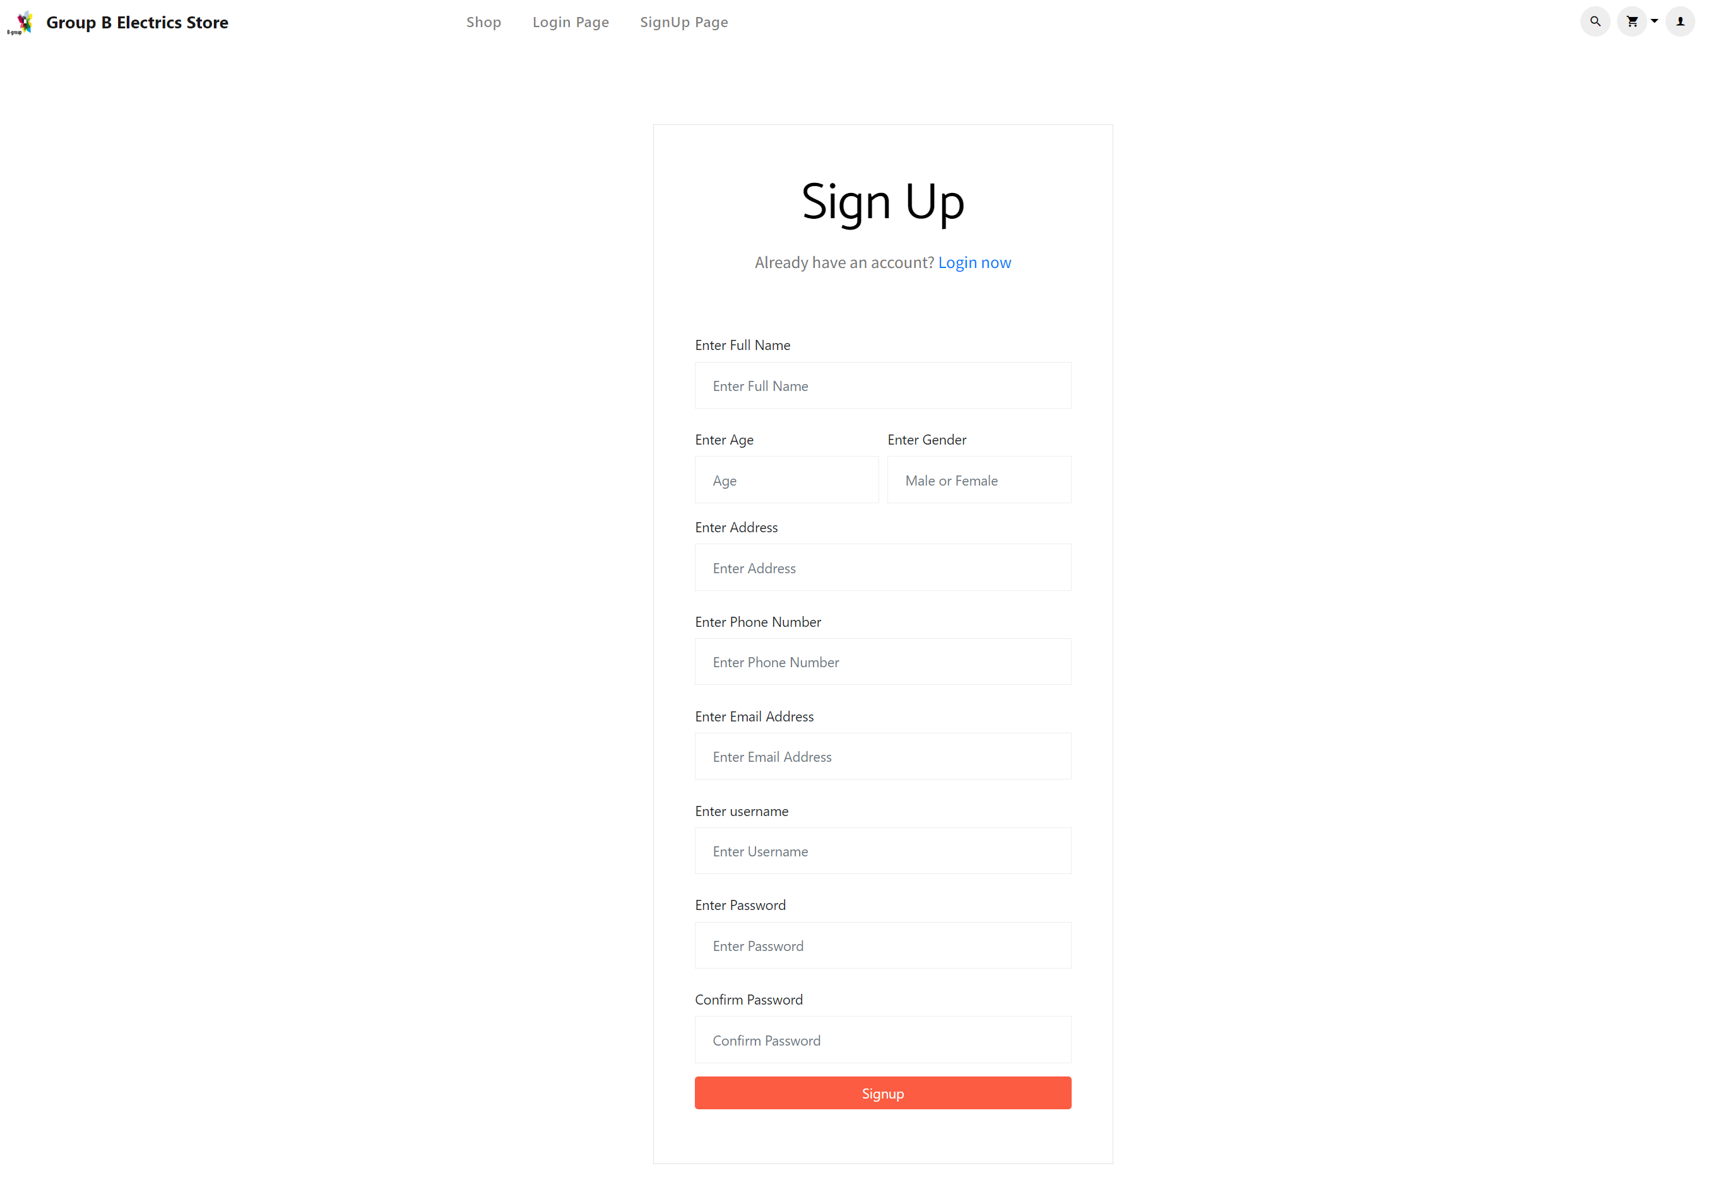
SIGN UP PAGE

Slide 16
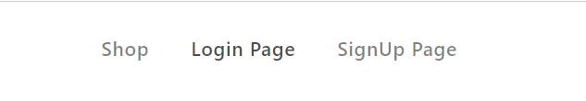
WHEN NOT LOGGED IN PAGE

Slide 17

LOGIN WITH ADMIN ACCOUNT PAGE

Slide 18
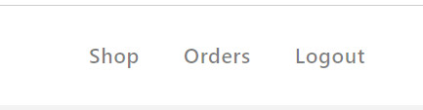
LOGIN USER RIGHTS PAGE

Slide 19
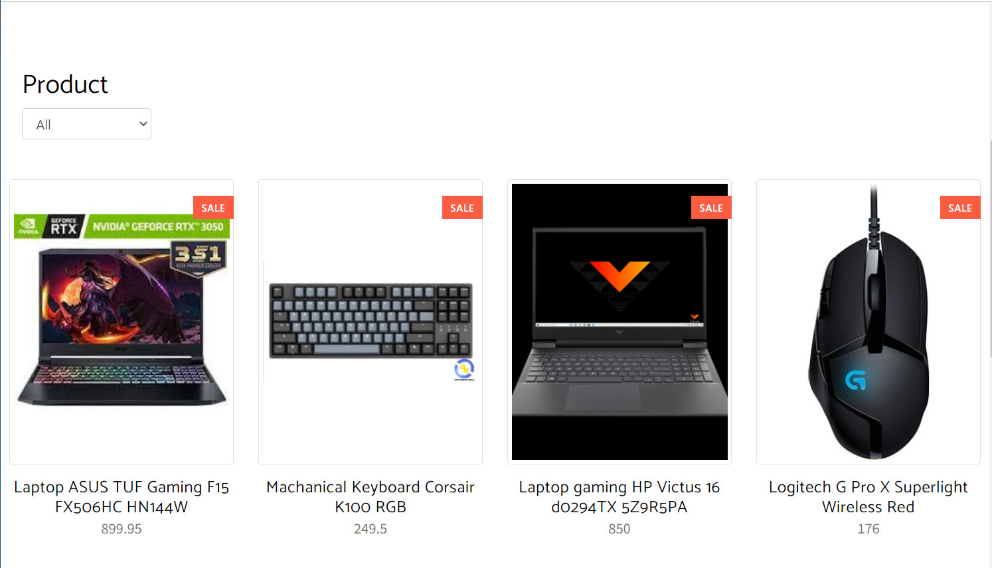
LIST PRODUCT PAGE

Slide 20
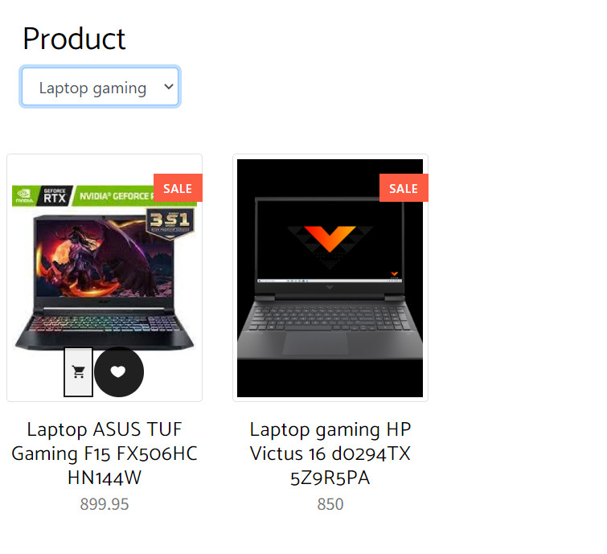
TYPE OF PRODUCT PAGE

Slide 21
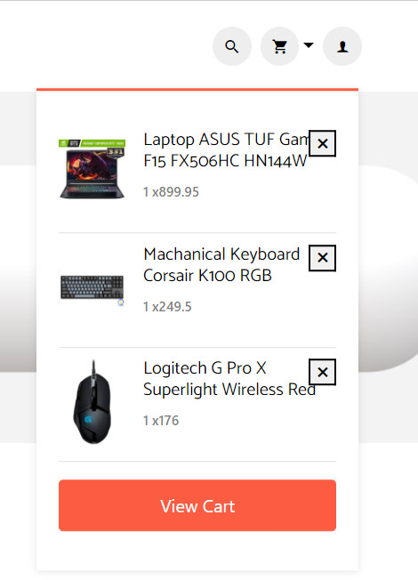
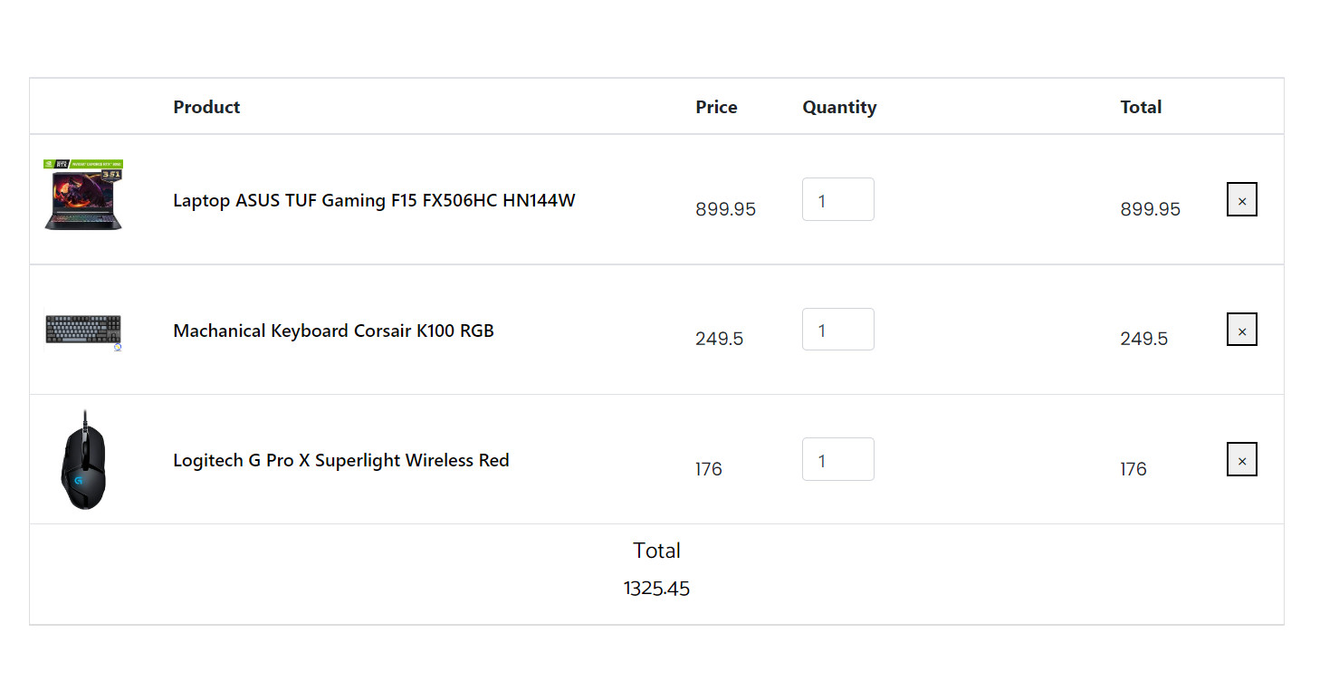
CART PAGE

Slide 22
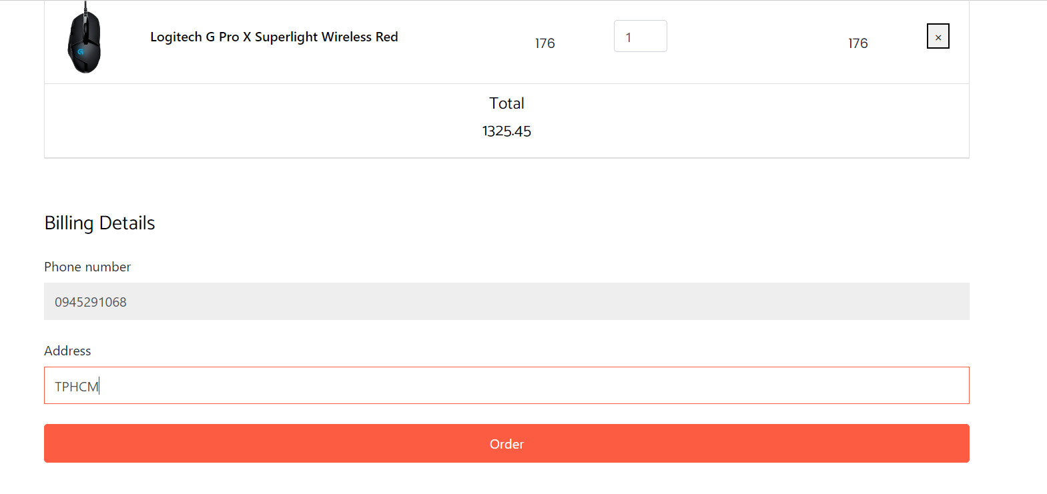
ORDER PAGE

Slide 23
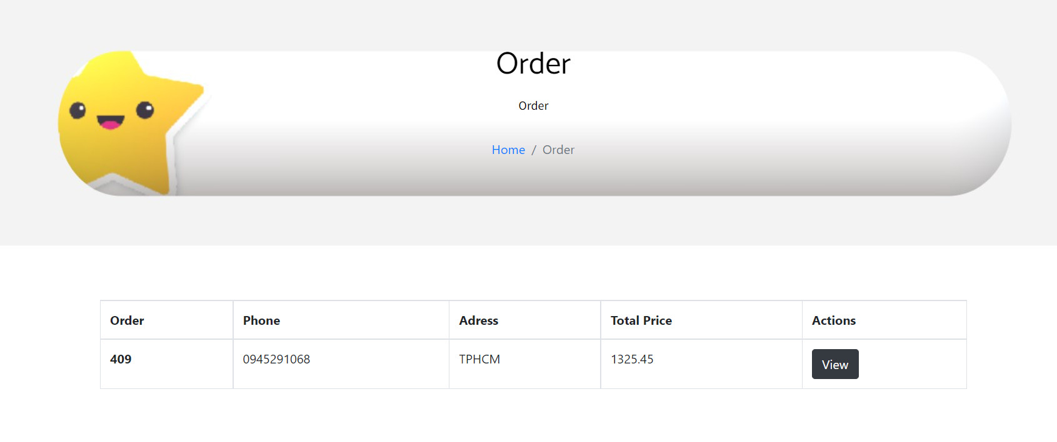
ORDER HISTORY PAGE

Slide 24
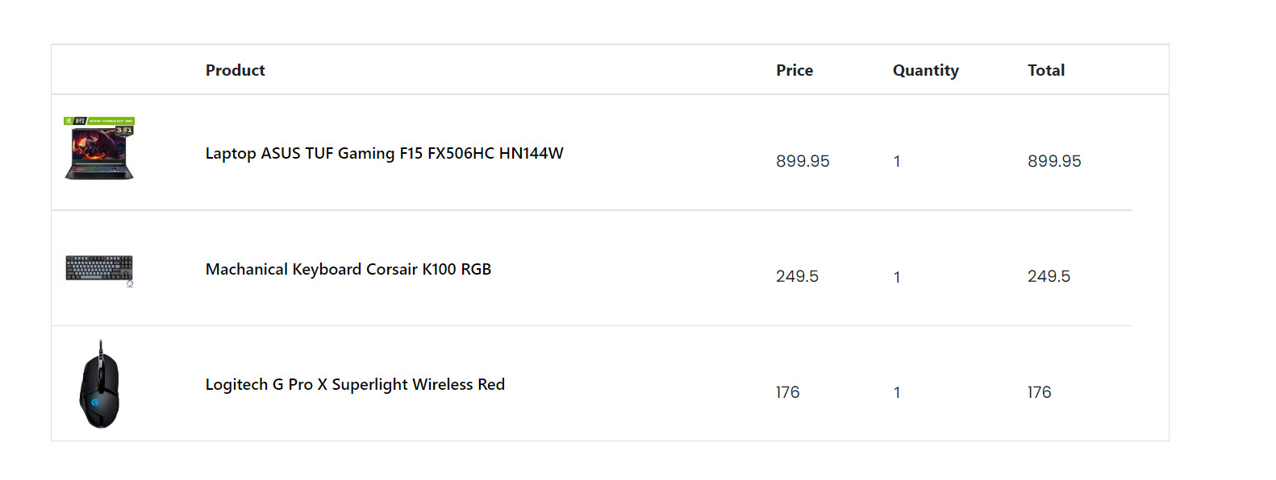
ORDER DETAIL PAGE

Slide 25
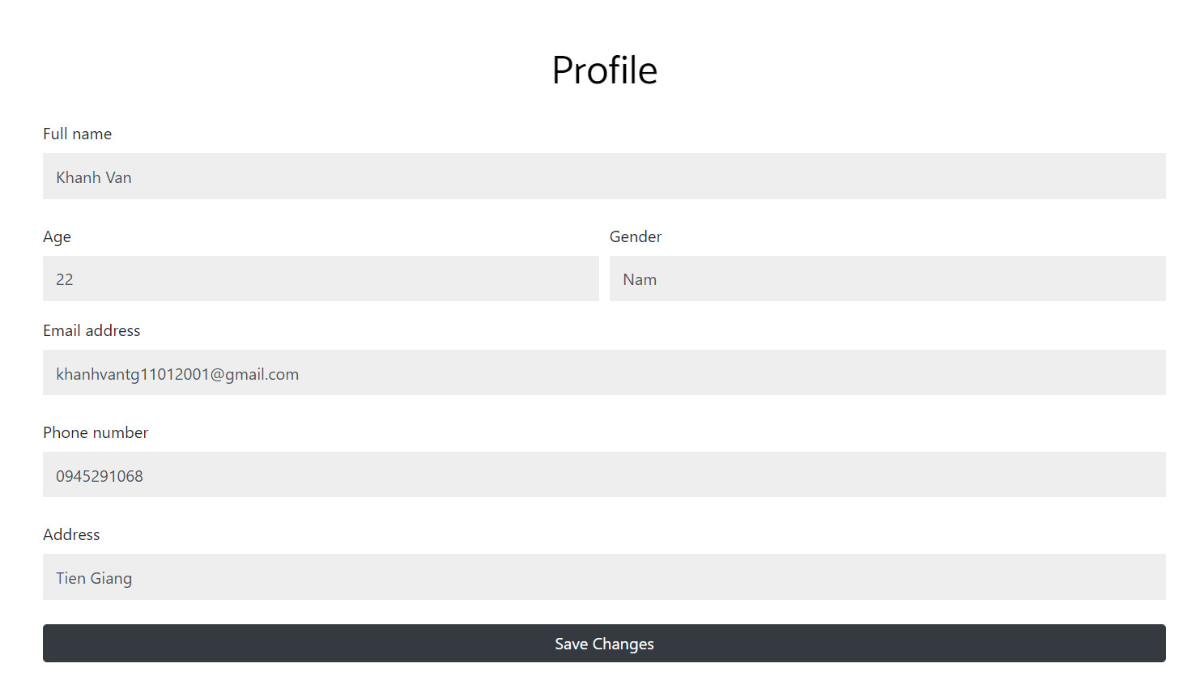
PROFILE PAGE

Slide 26
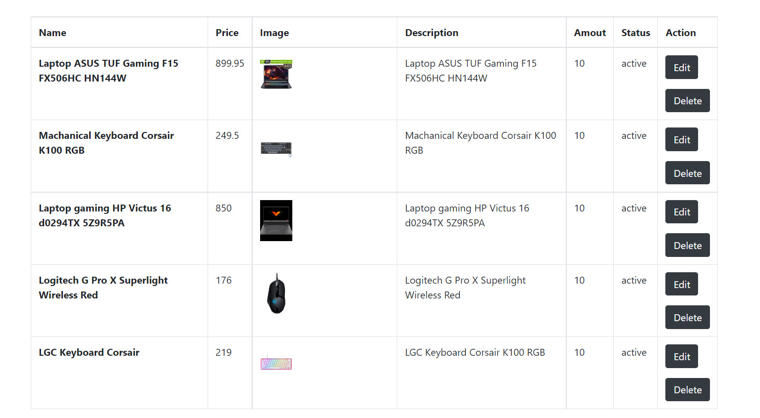
MANAGE PRODUCT PAGE

Slide 27
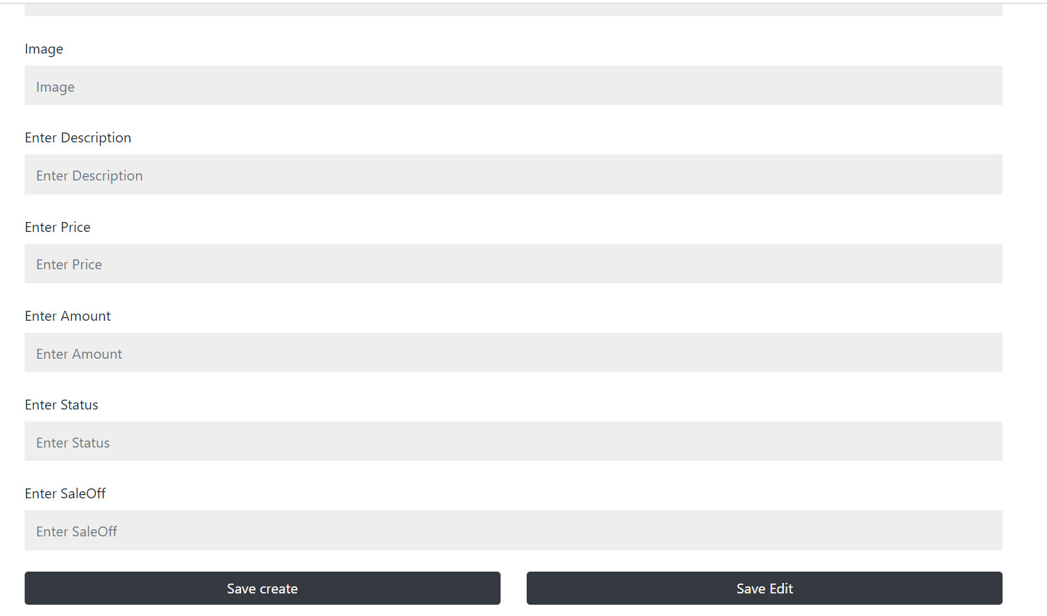
DASHBOARD PAGE

Slide 28
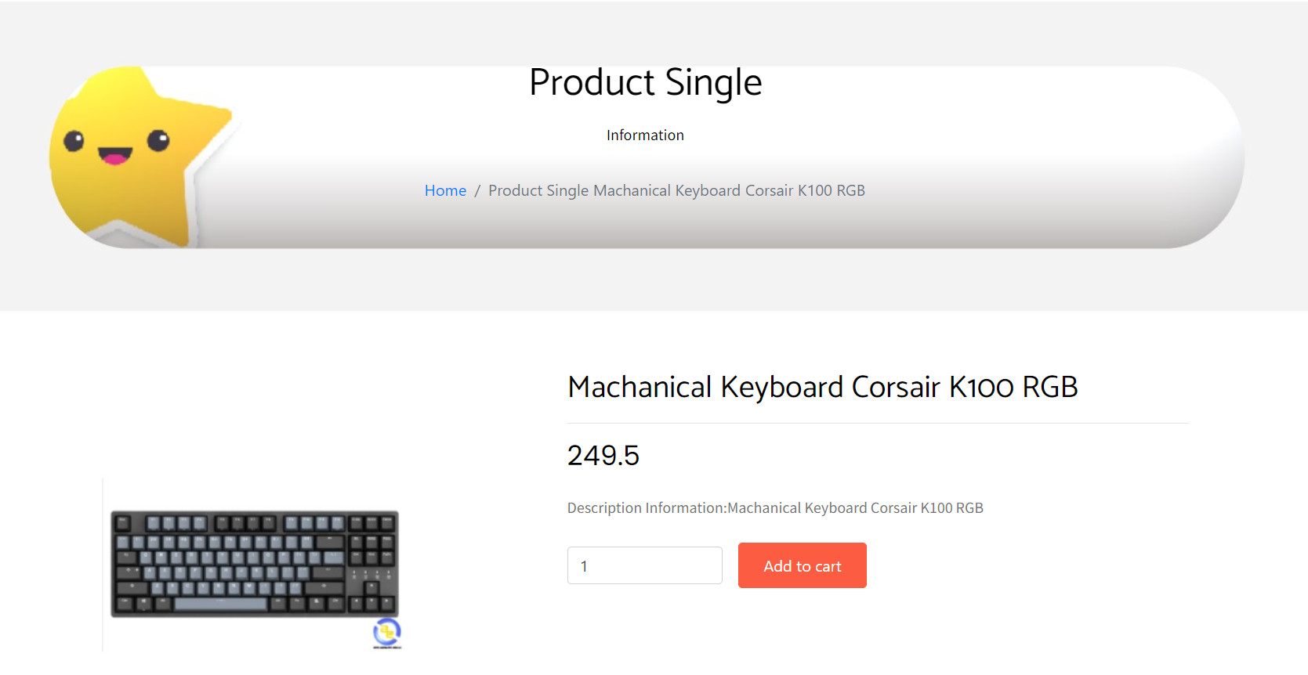
PRODUCT SINGLE PAGE

Slide 29
Conclusion and future scope
Future scope:
This application involves almost all the basic features of a Website selling technology stuff.
The future implementation will be to support customer buying.
Conclusion:
The project entitled “Website Selling Technology Stuff” is developed using Angular, HTML, CSS as the frontend and Oracle database, Java, Spring Boot as the backend, and the process of online management of products.
This project covers only the basic features required.

Slide 30
THANK YOU
GB
GROUP B

